Slide 1
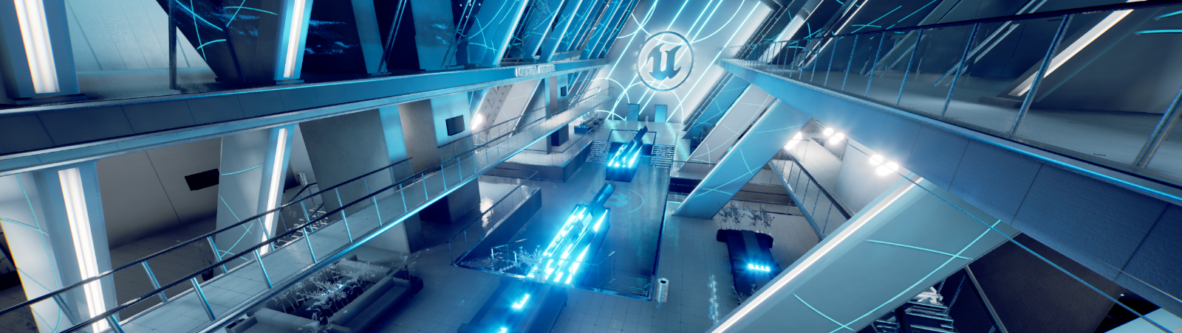
UNREAL ENGINE ENVIRONMENT
Jesper Larsson, Julian Voith, Eric Edelo

Slide 2
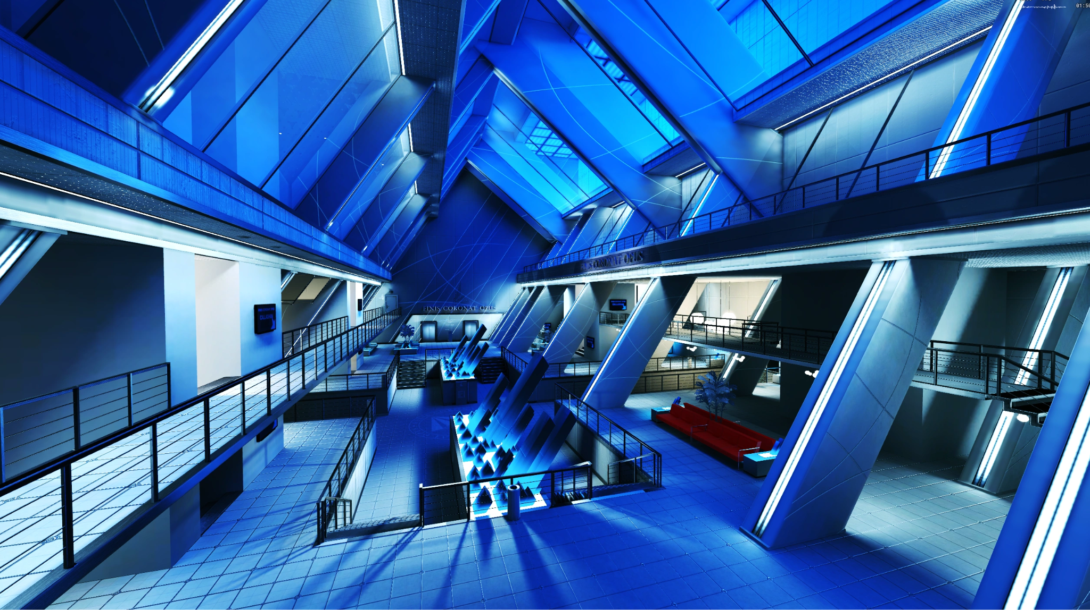

Idea
Real-time environment in UE5
Simple & minimal designs
Inspired by Mirror’s Edge (2009)
Notes:
Goal create a something in UE5
Based on knowledge simple geometry and on existing game title for reference
Resulted in Mirrors Edge, due to its smart usage of textures and lighting to create a good looking and immersive environment
Evaluation of different levels by screenshots and videos
Resulted in a indoor scene

Slide 3
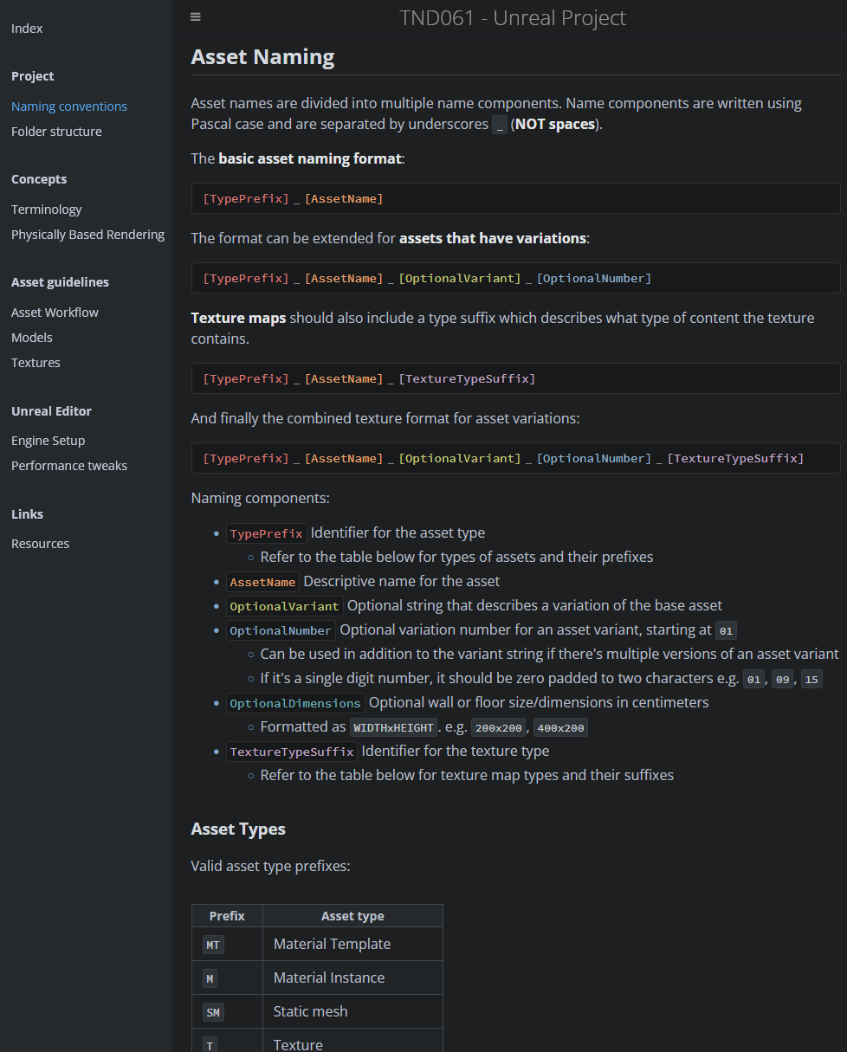
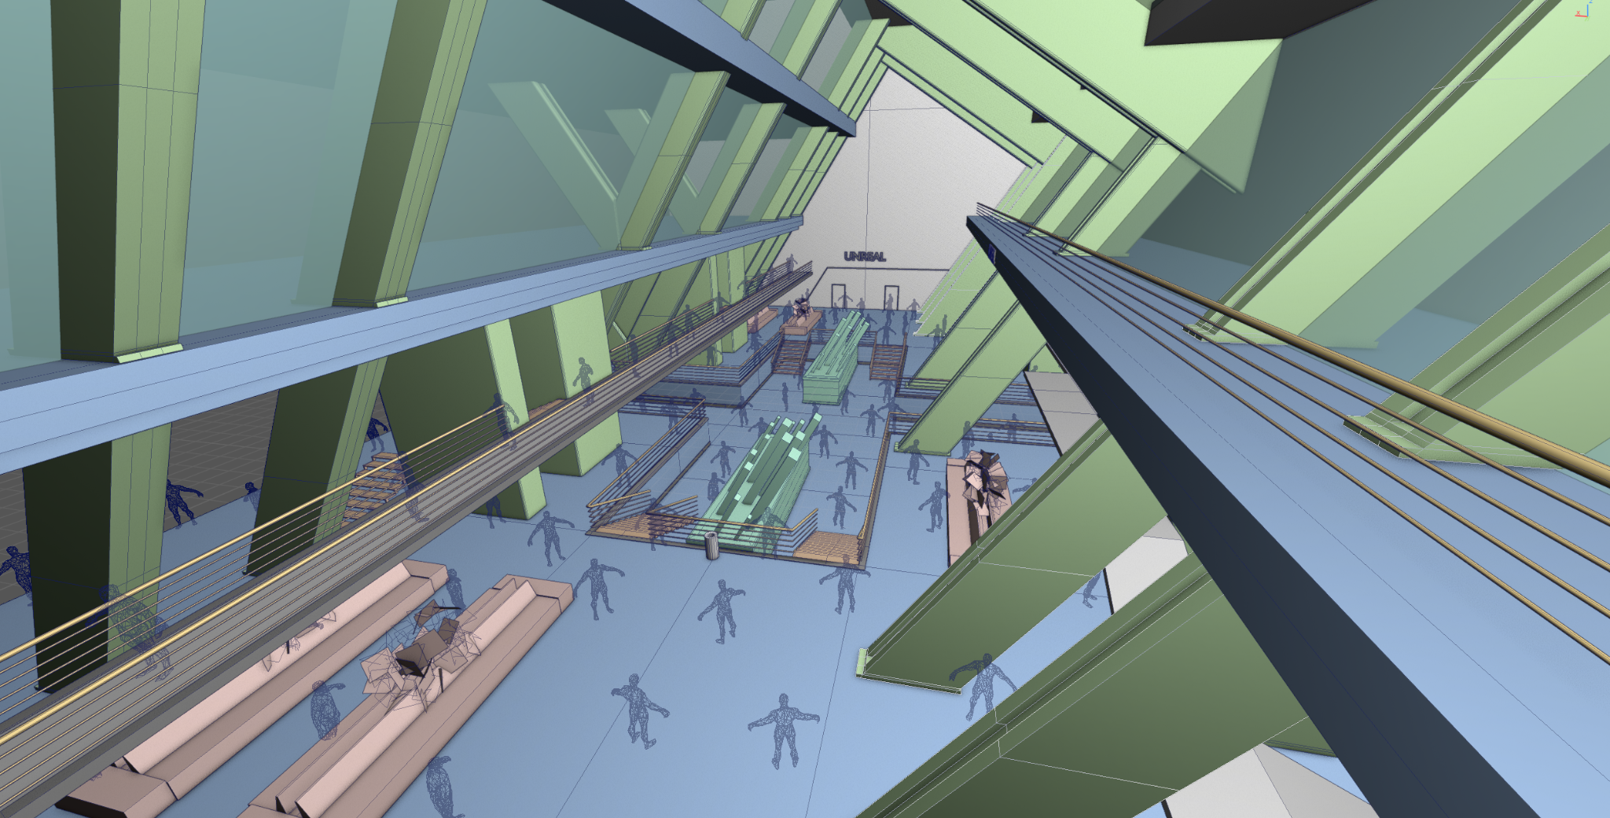
Pre-production
Learning the engine
Project structure, documentation wiki
Block-out of scene volumes
Identified key assets to create

Slide 4
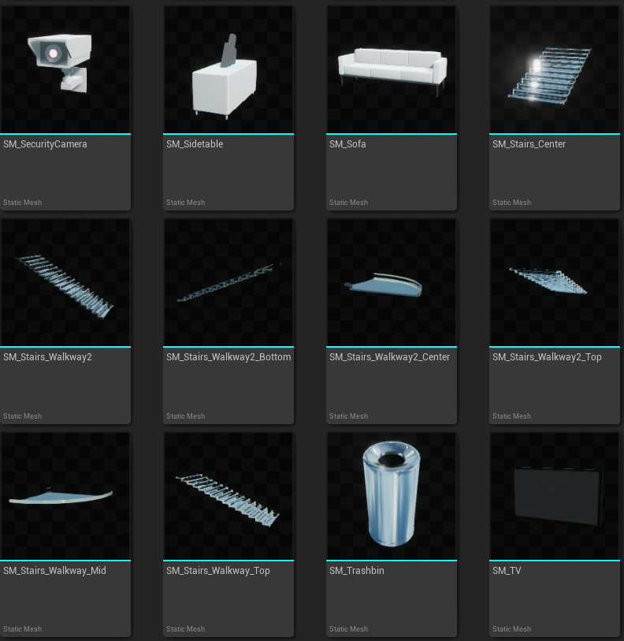
Asset creation
Assets divided amongst members
Modeling in Maya & Blender

Slide 5
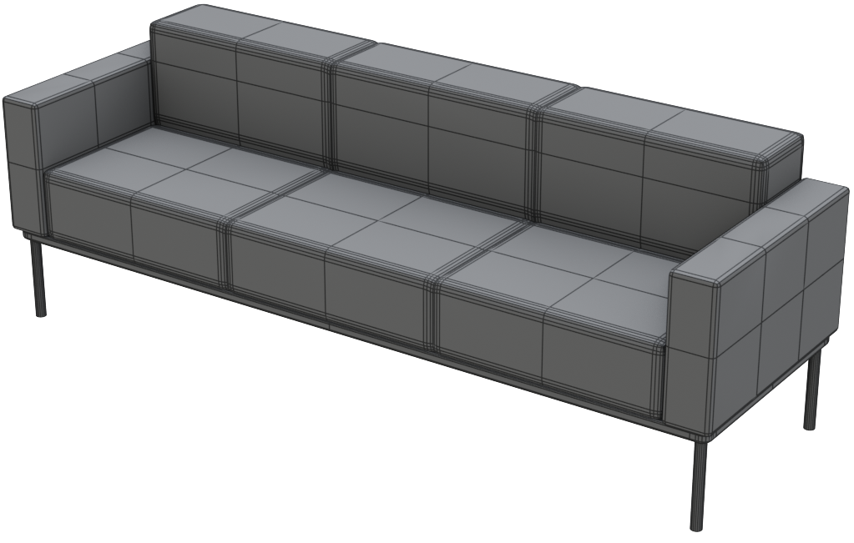
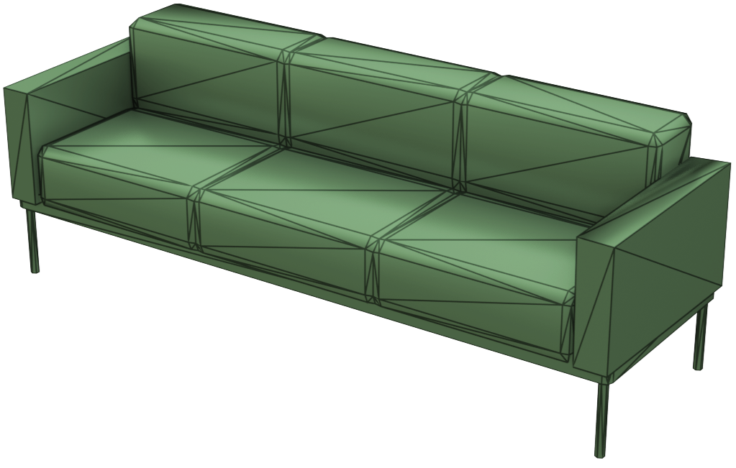
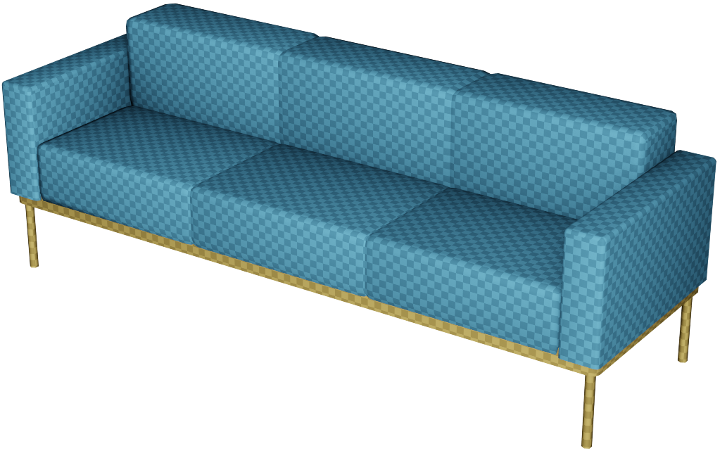
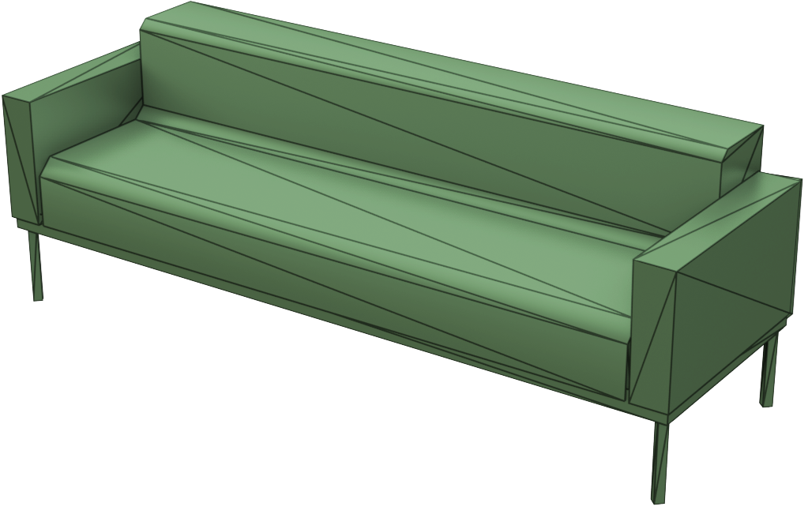
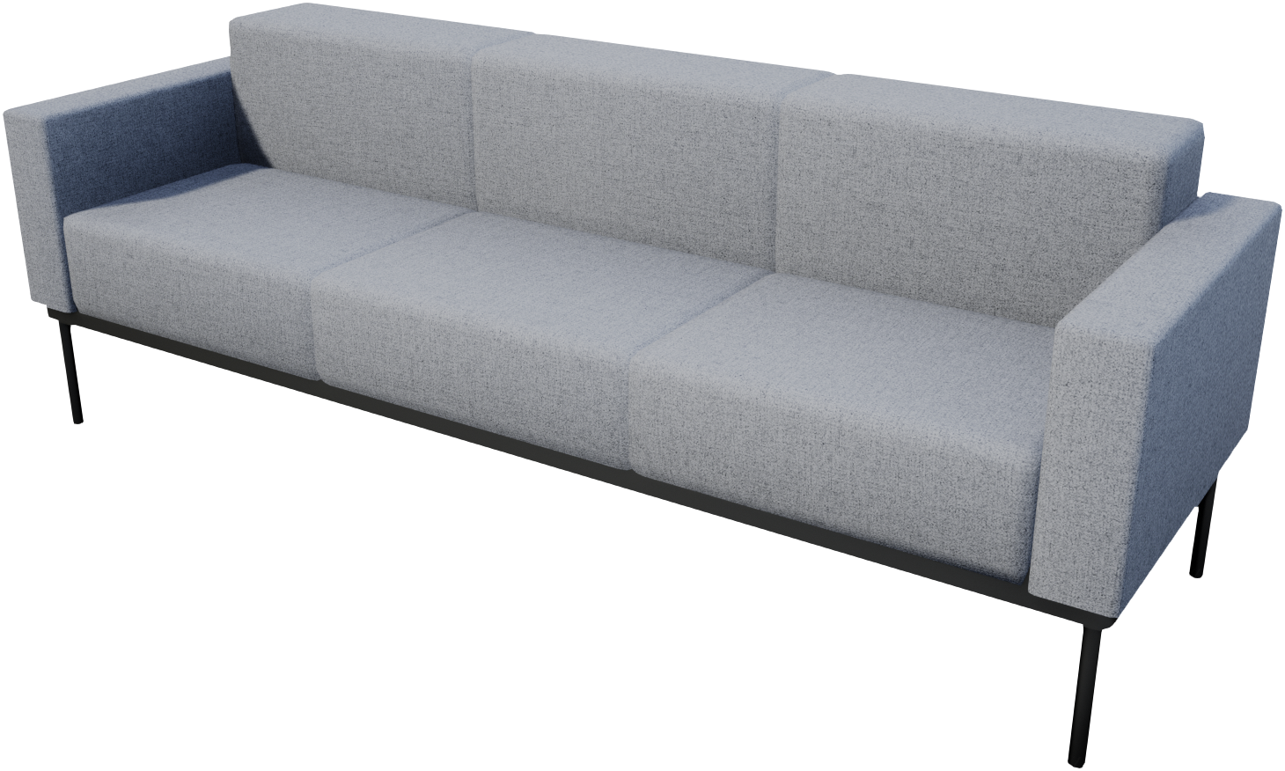
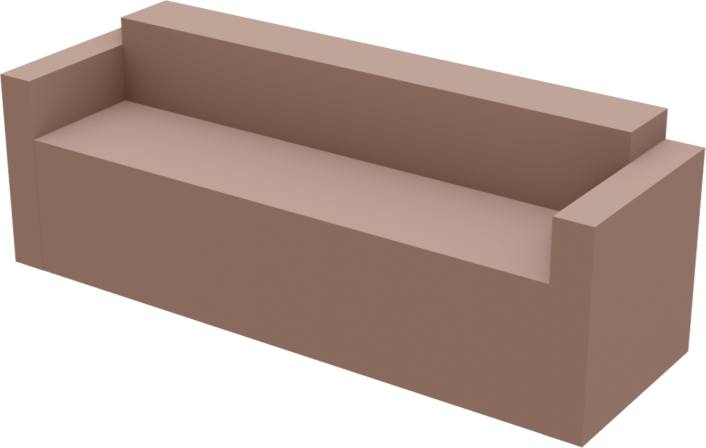
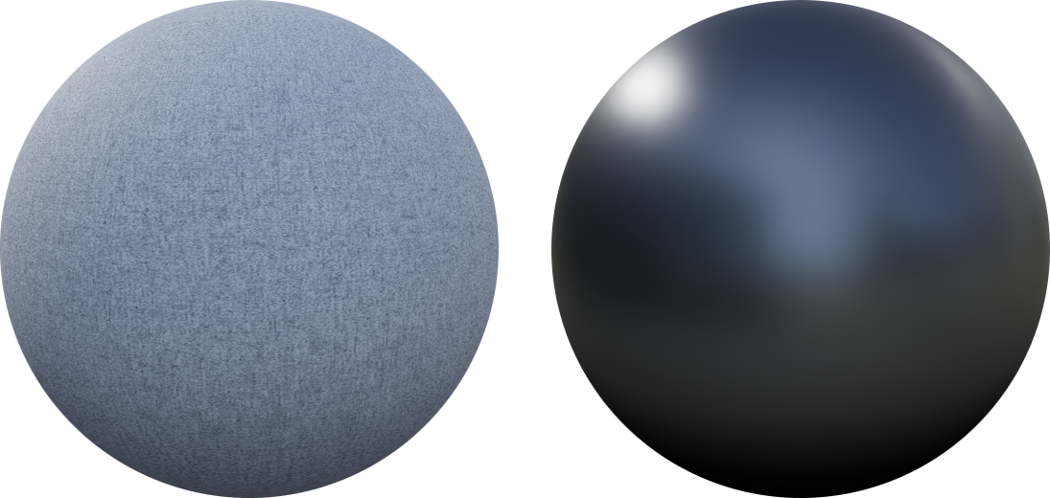
HIGH-POLY
LOW-POLY
UV-UNWRAP
LOD(s)
COLLISION/
CULLING

Slide 6
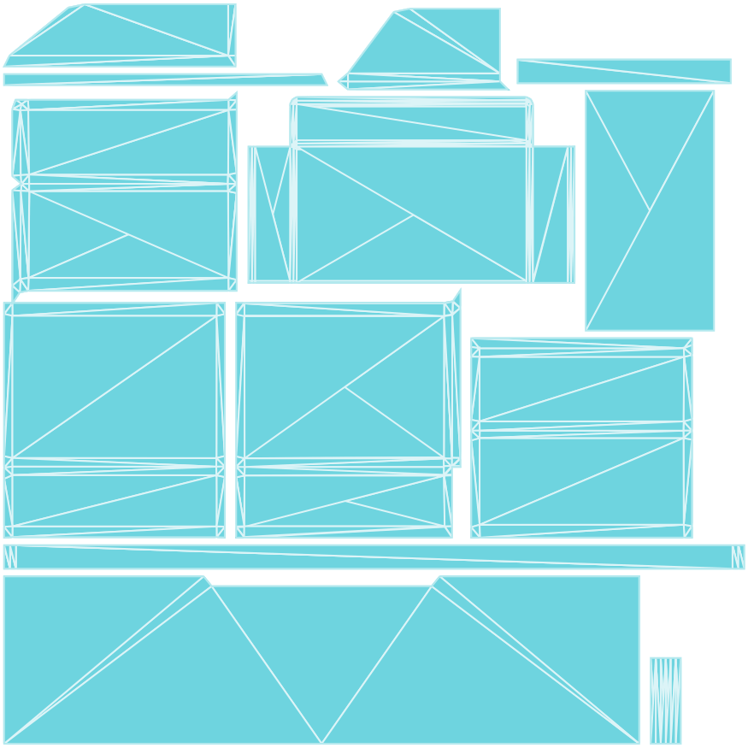
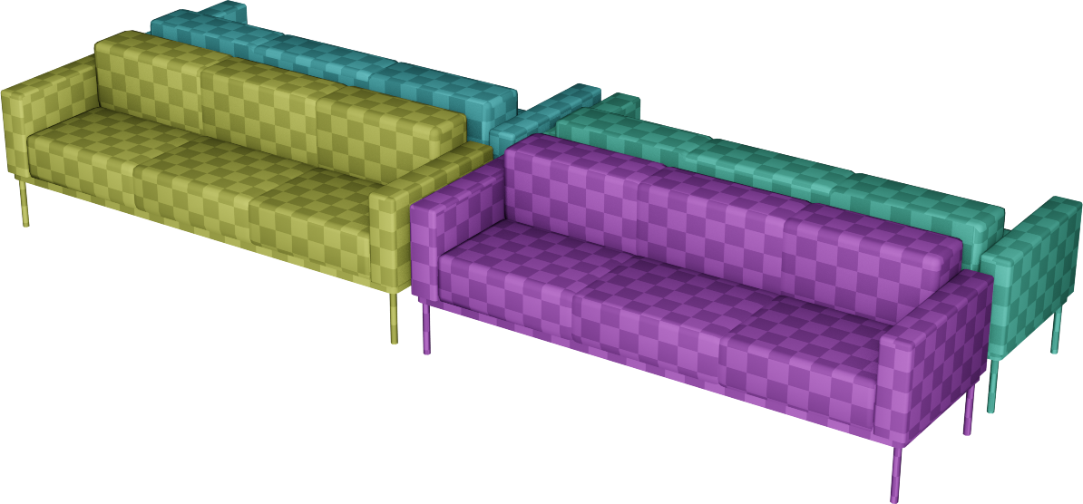
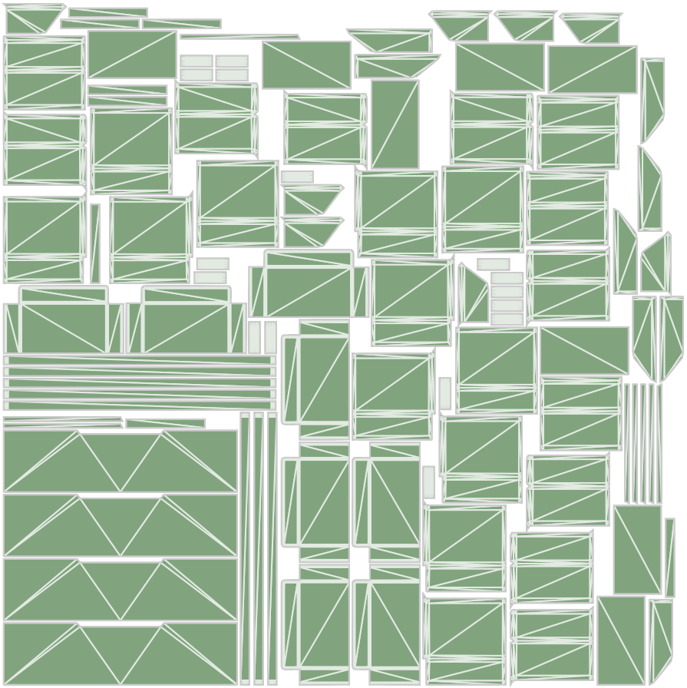
MATERIAL UV:s
PACKED LIGHTMAP UV:s

Slide 7
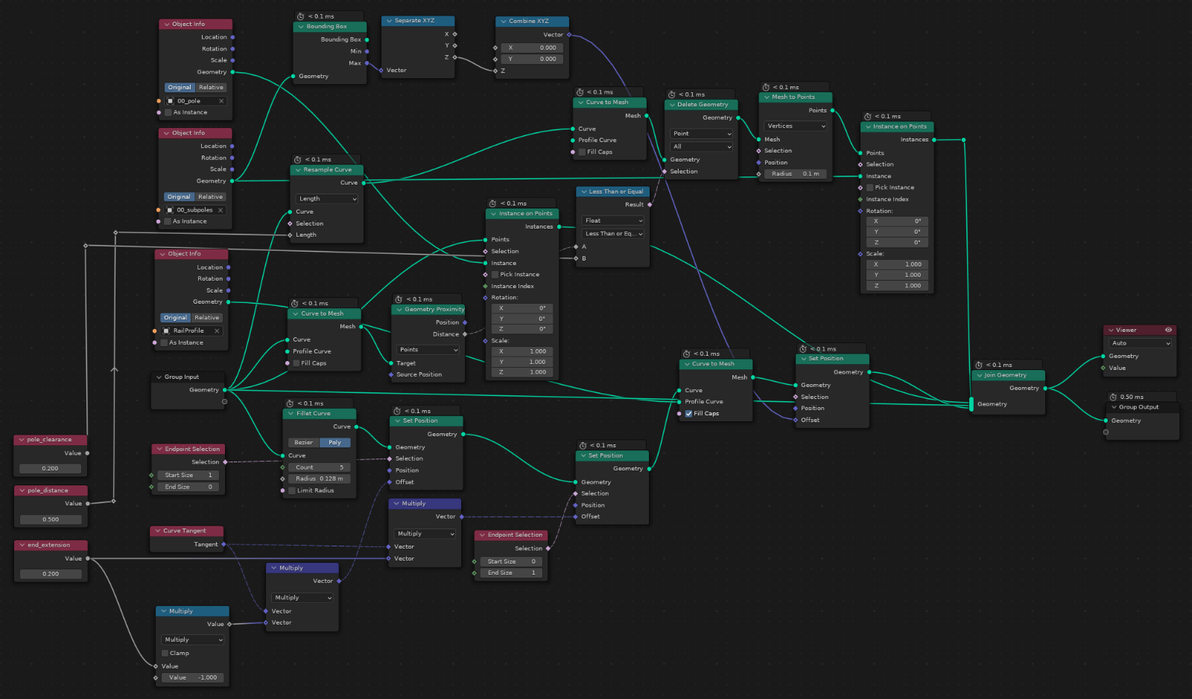
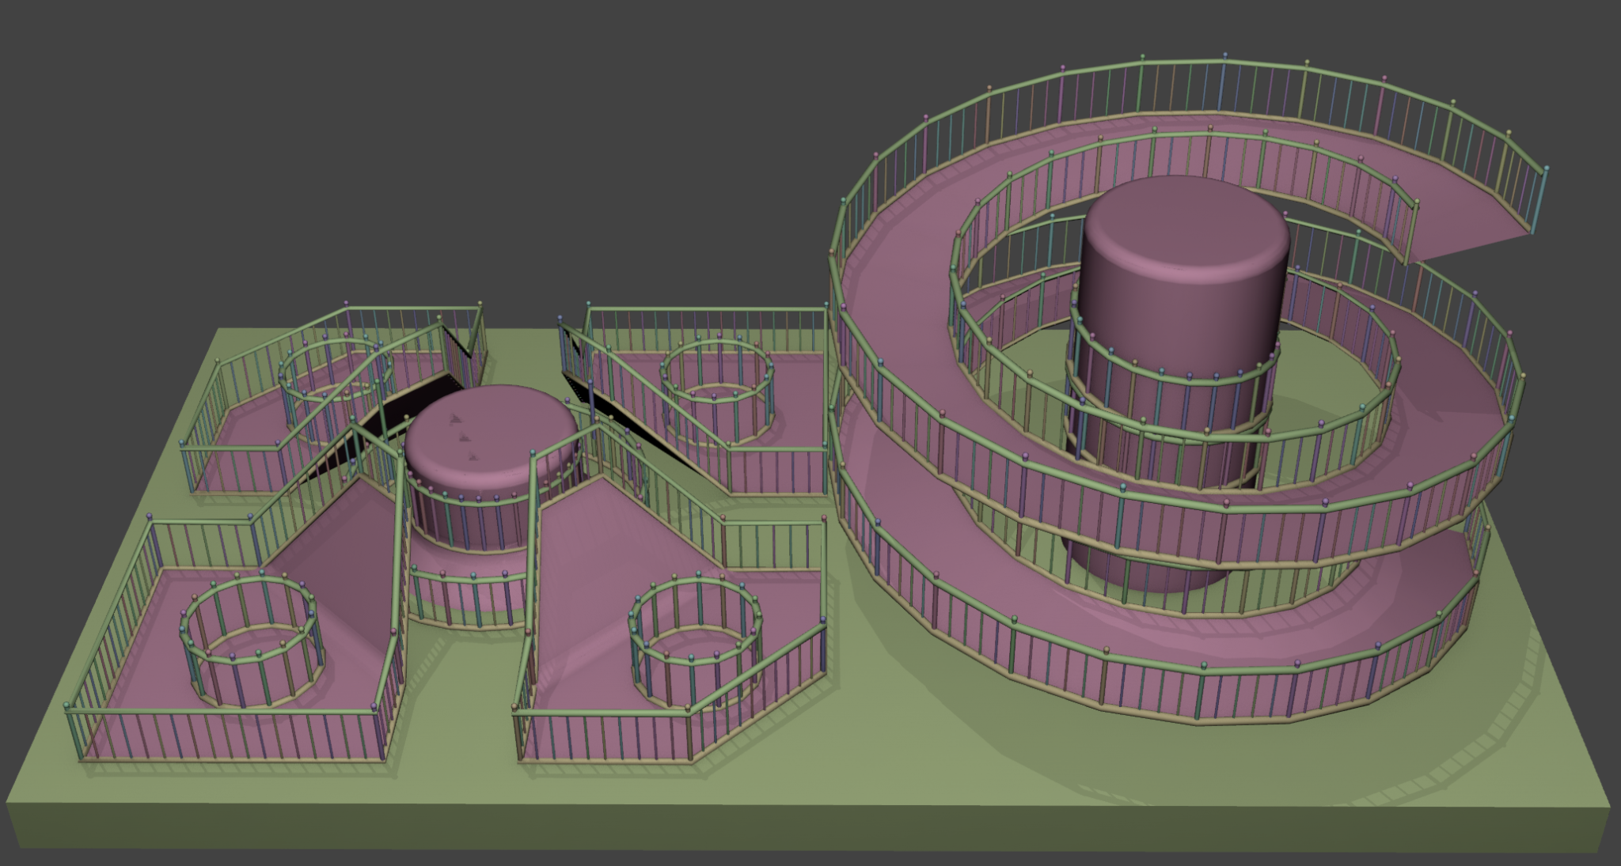
Procedural tools
Blender Geometry Nodes + UE Blueprints
Fence/rail placements
Staircase generation

Slide 8
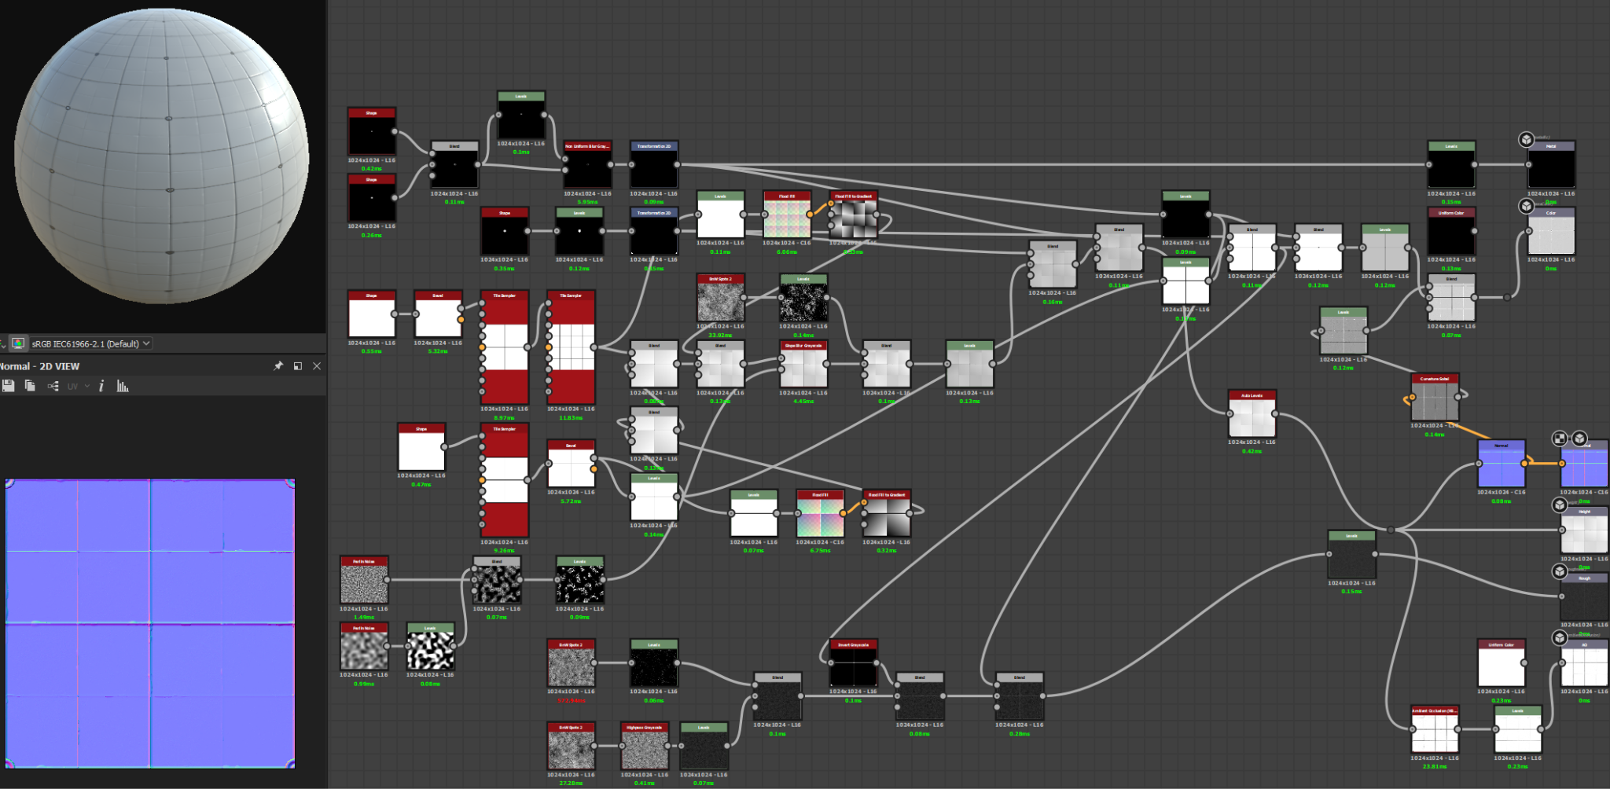
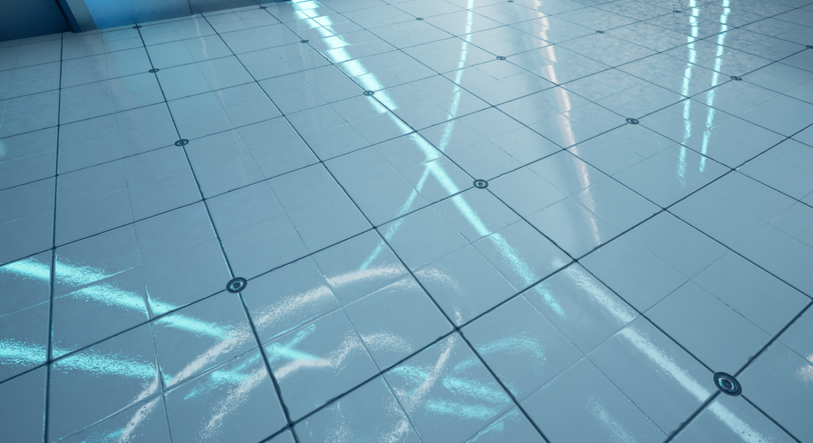
Texturing
PBR materials
Albedo, metallic, roughness
Tile-able/repeating textures
Procedural textures in Substance Designer
Master material with instances

Slide 9
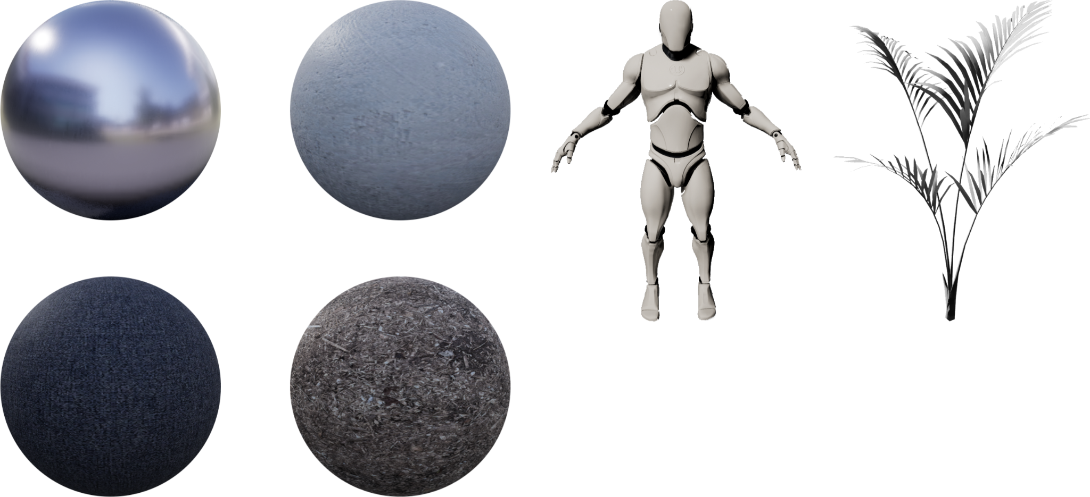
Third party resources
Unreal mannequin (included with UE5)
Dirt, textile, metal material & plant model- Quixel Megascans (UE licensed)
Plaster texture - AmbientCG.com (CC0 licensed)

Slide 10
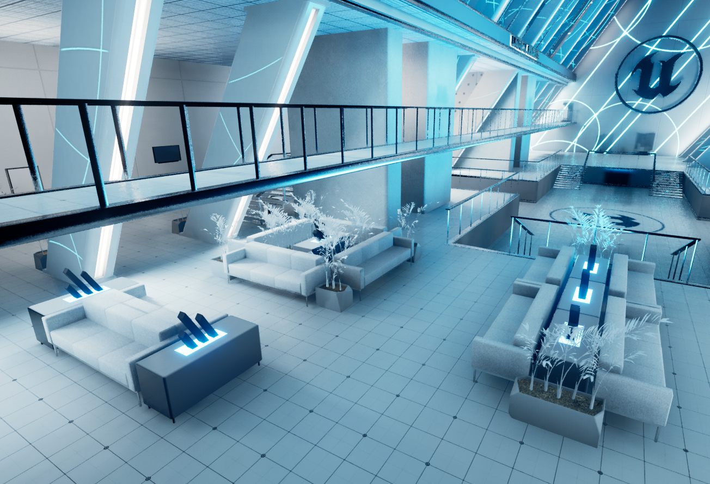
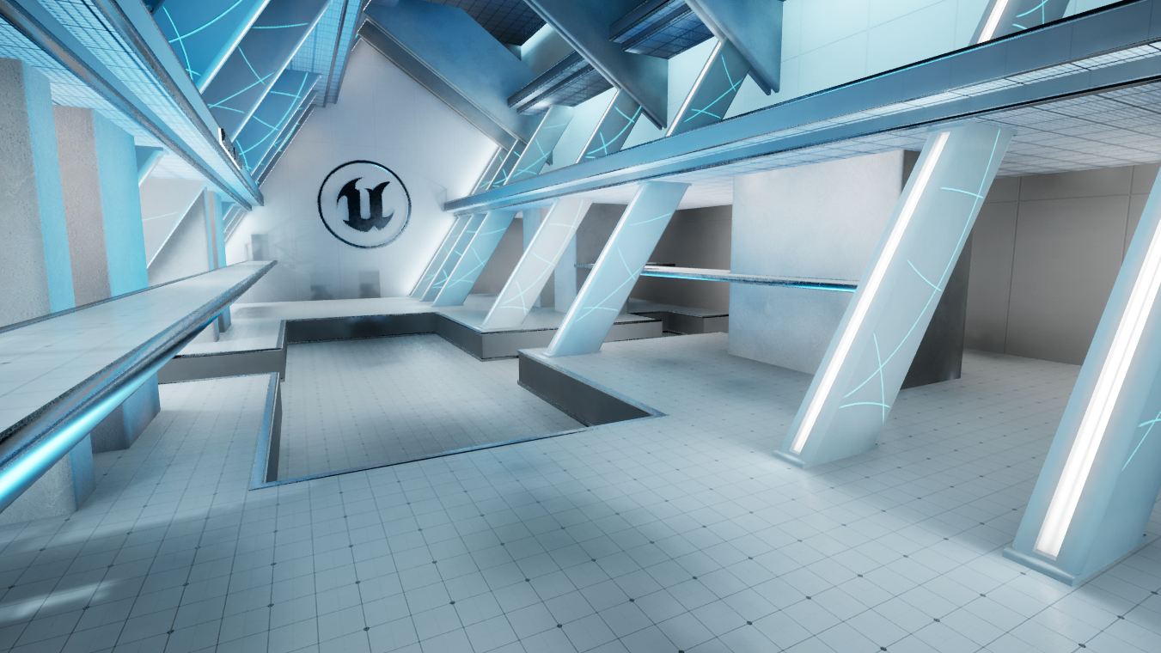
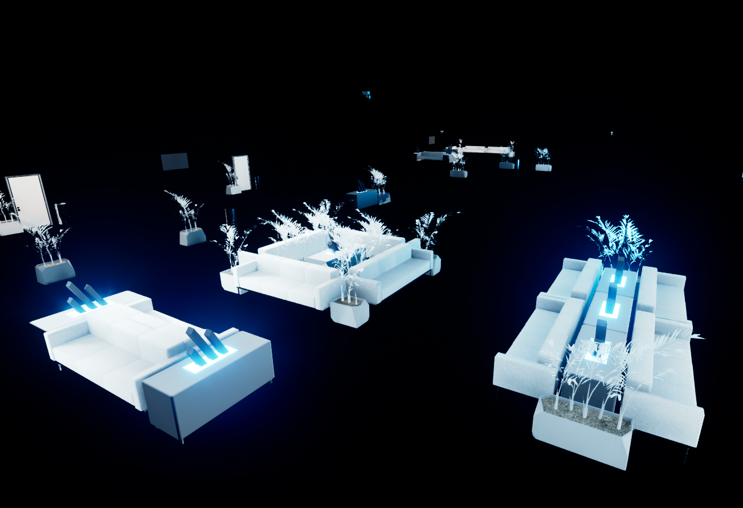
Scene assembly
MAIN LEVEL
SUBLEVEL
SUBLEVEL

Slide 11
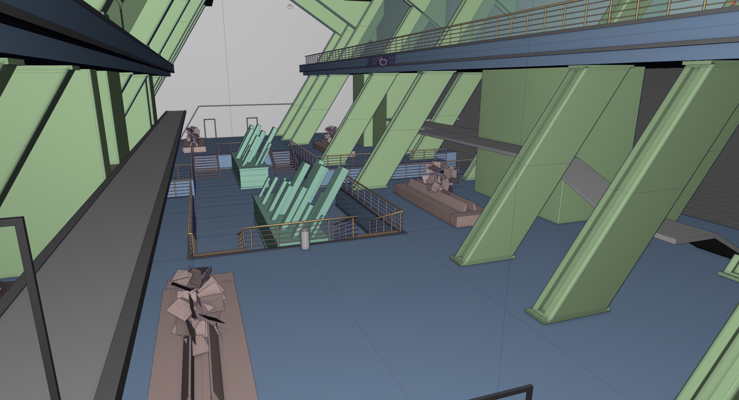
BLOCKOUT

Slide 12
MAIN STRUCTURE

Slide 13
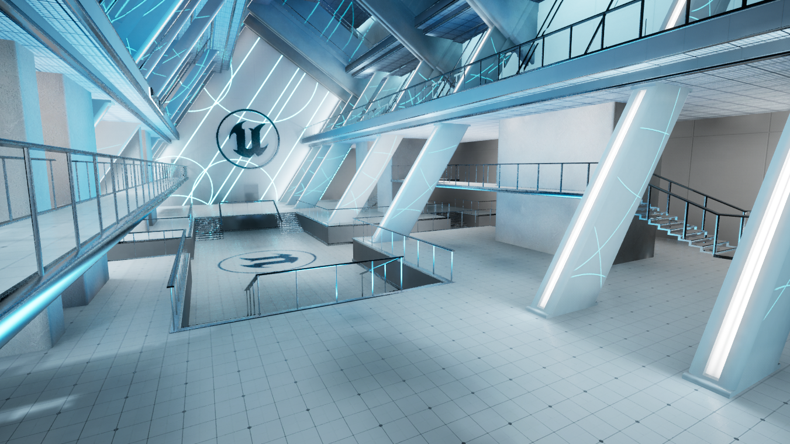
DETAILS & DECALS

Slide 14
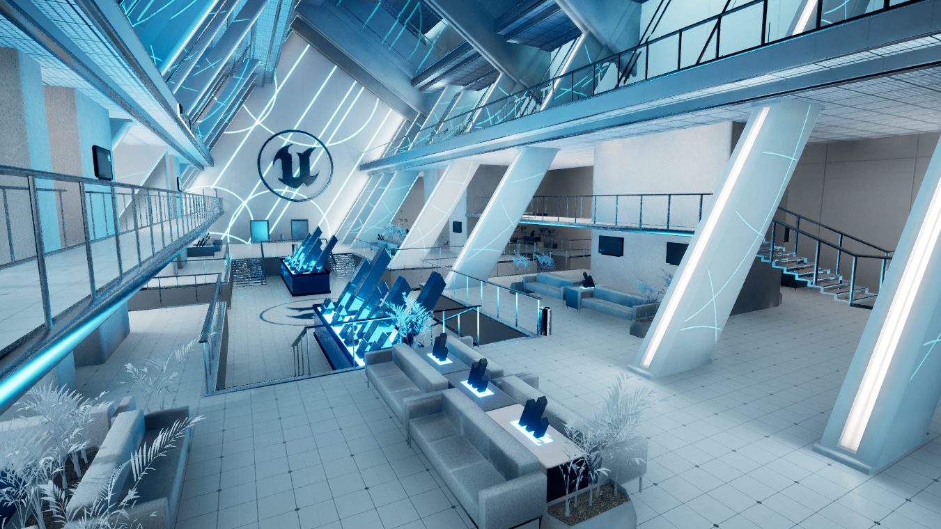
PROPS & LIGHTS

Slide 15
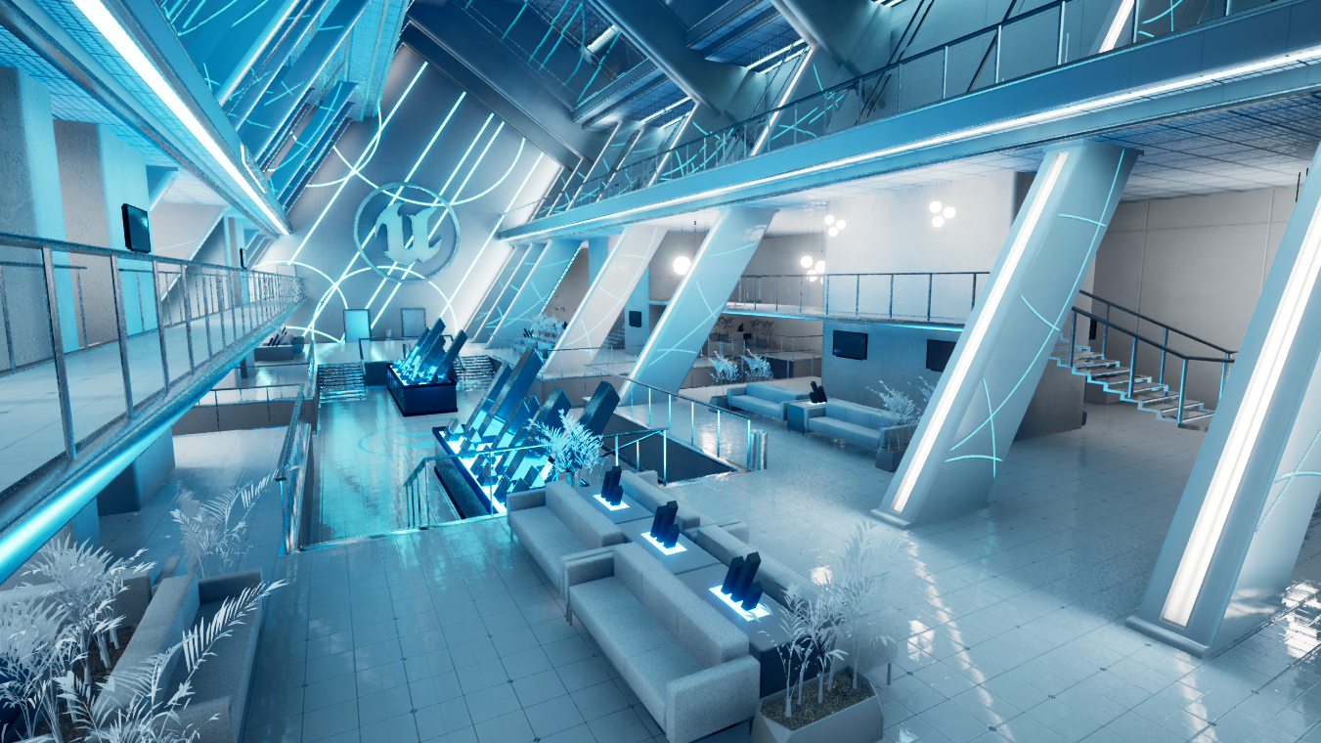
BAKES & POST-PROCESSING

Slide 16
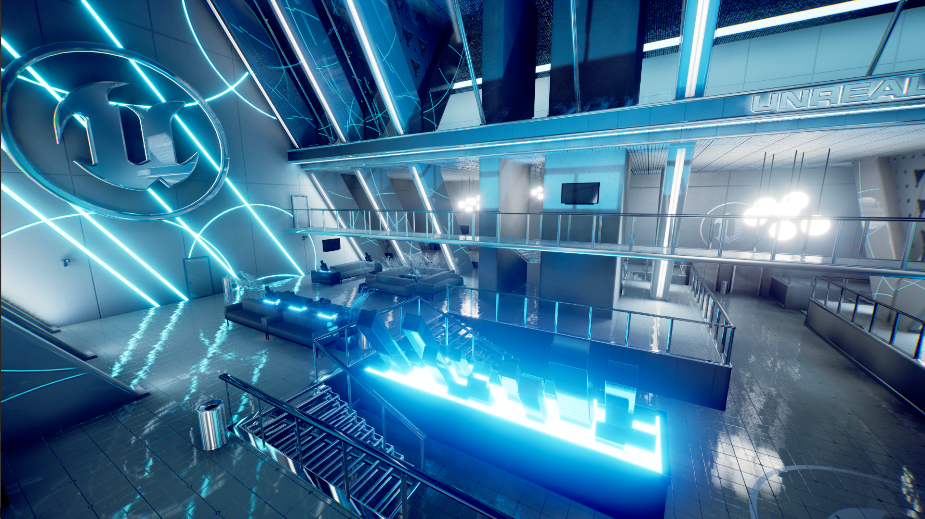
Lighting & post-processing
In-engine lightmapper
Static + volumetric lightmaps
Reflection probes
Screen-space reflections
Color grading & adaptive exposure

Slide 17
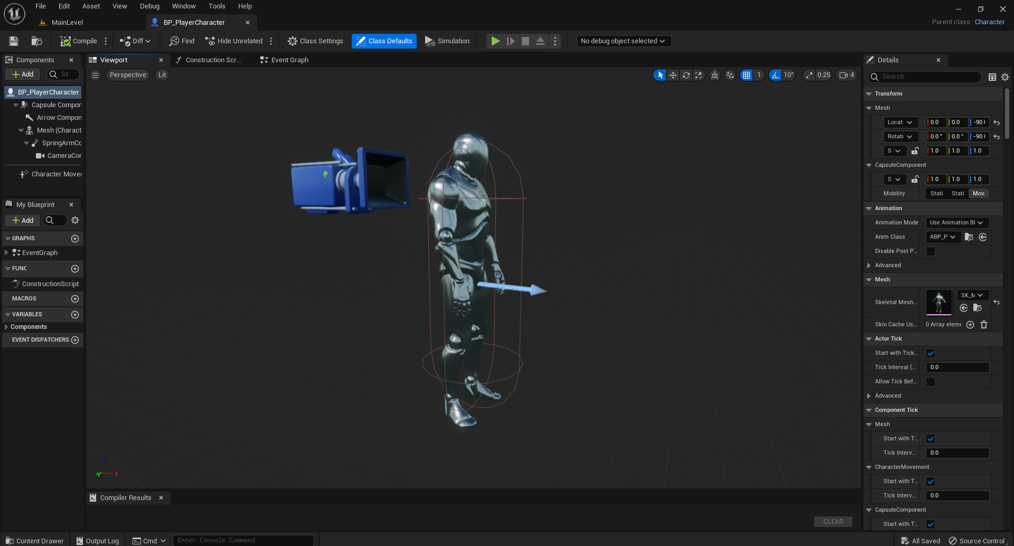
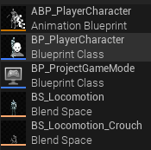
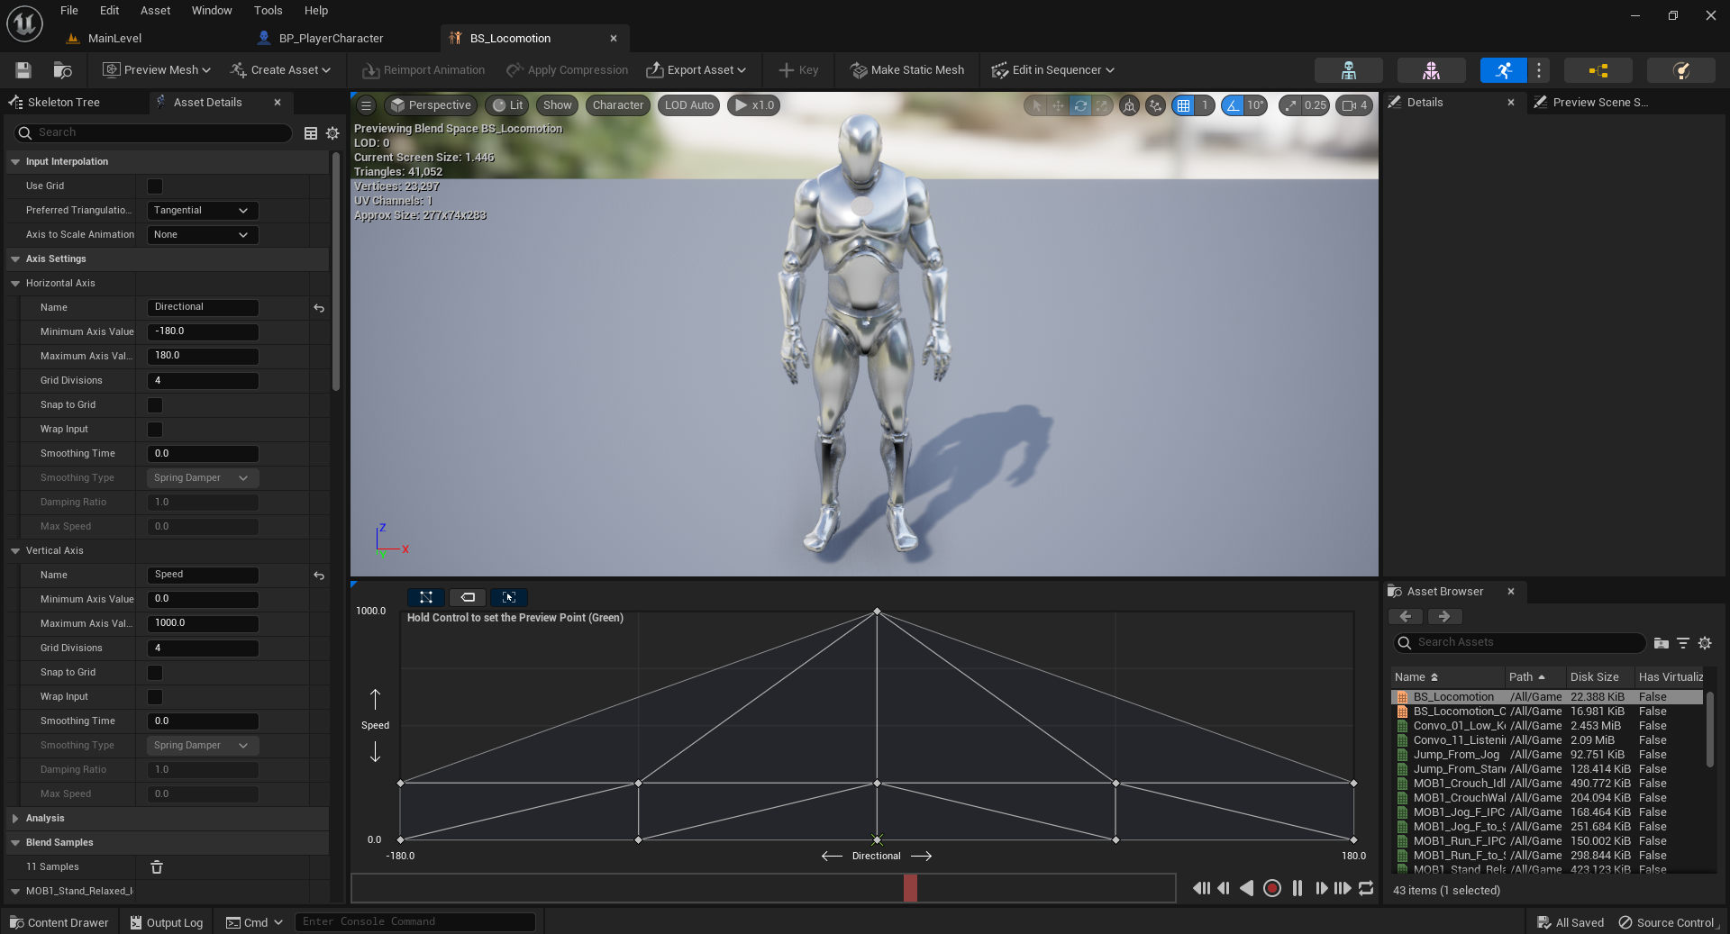
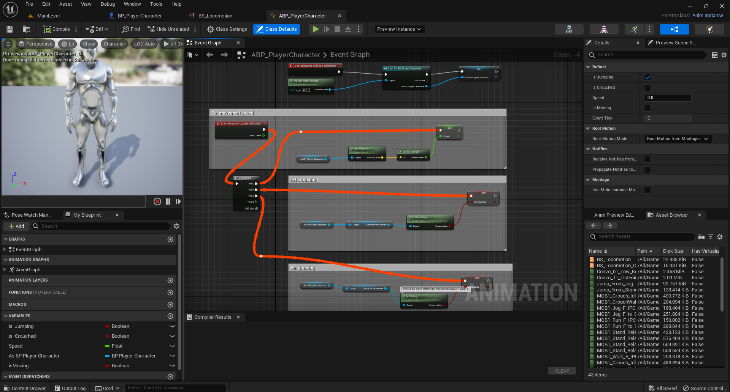
Implementation of a character
Character Blueprint
Blend Space
Asset files
Animation Blueprint

Slide 18
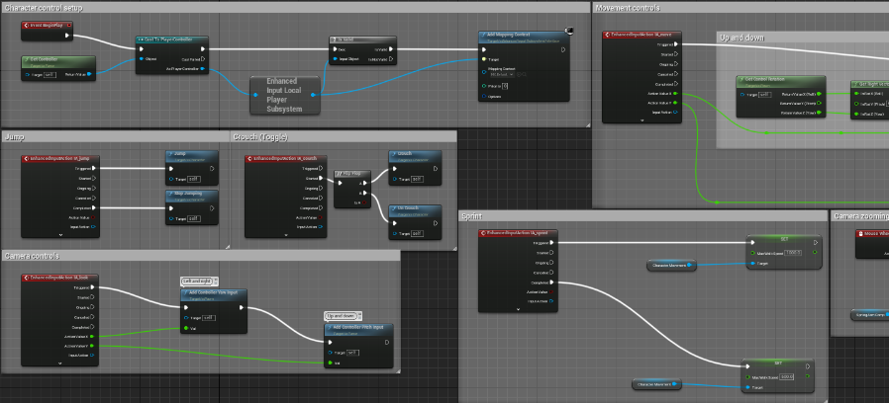
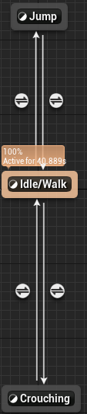
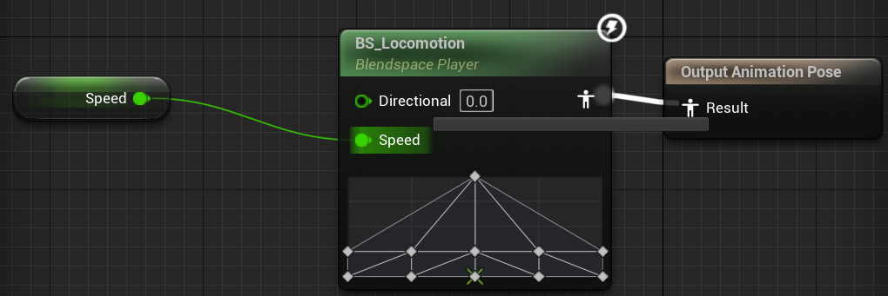
Implementation of a character
Asset files

Slide 19
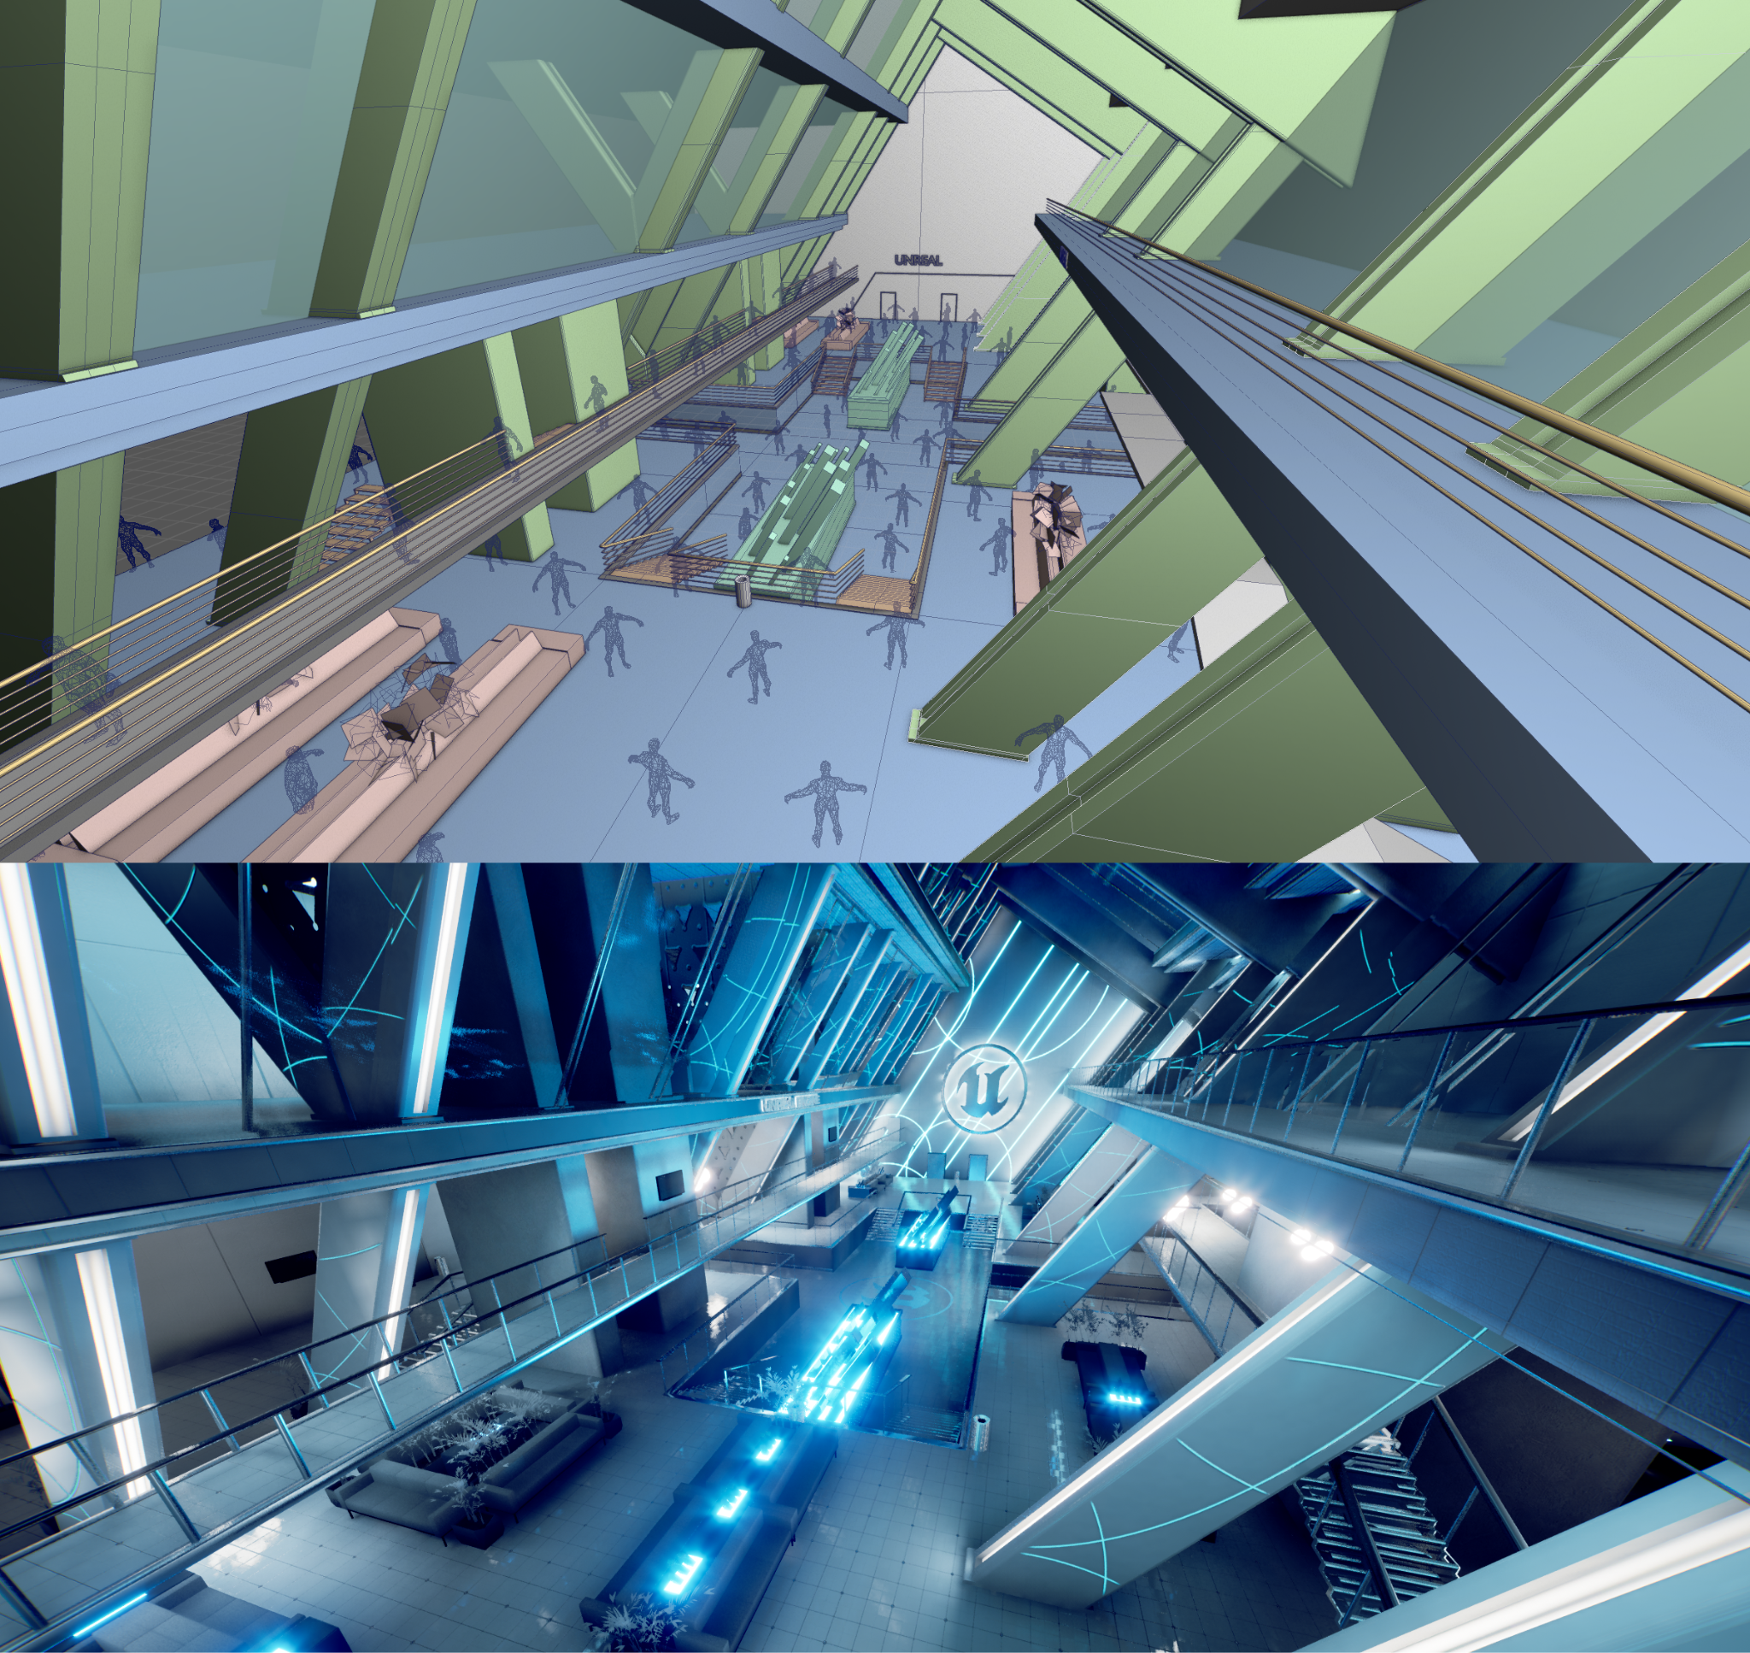
Result

Slide 20
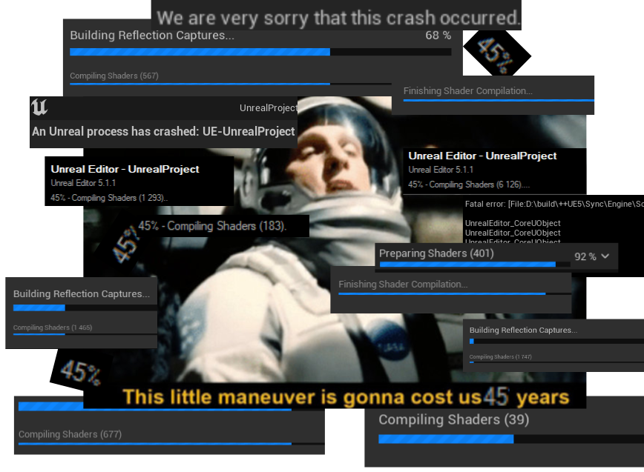
Problems & summary
Frequent shader compilation, builds & crashes
Hardware & feature compatibility
Raytracing, fully dynamic lighting
Packing texture channels
Created a functional real-time environment
Learned a lot about Unreal Engine

Slide 21


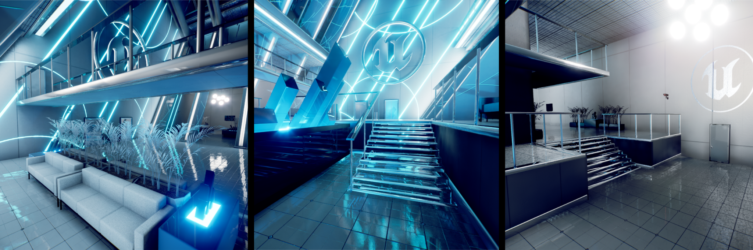
Questions?

